Slide 1
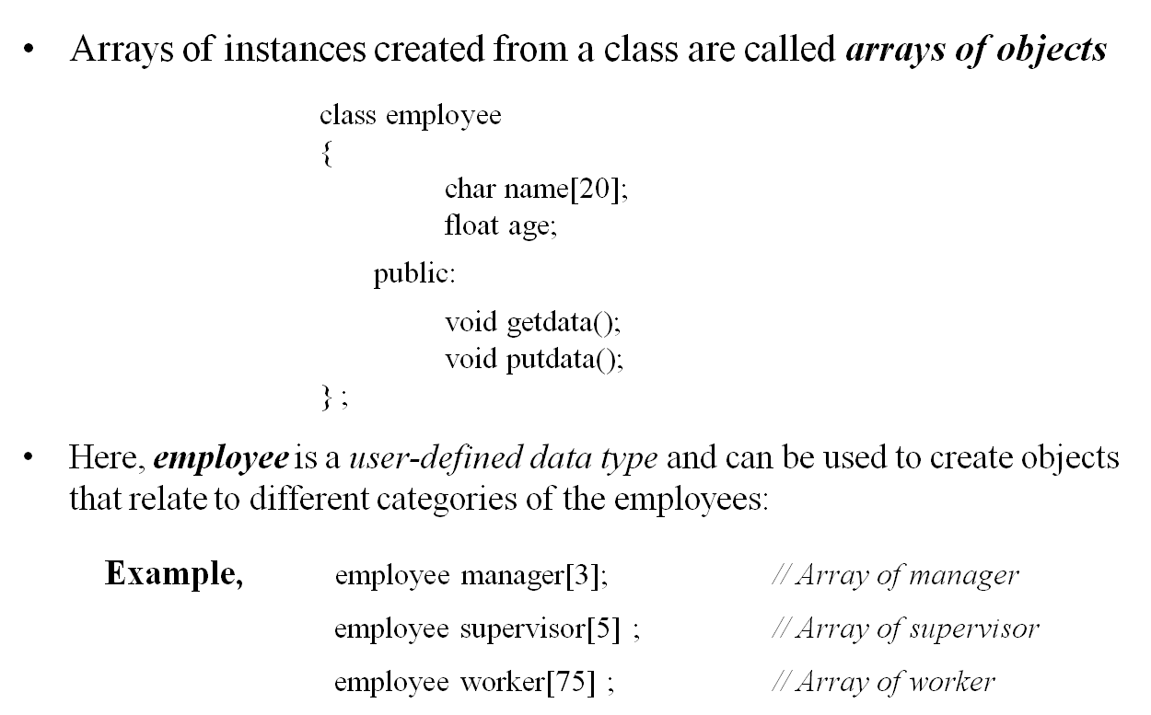
Arrays of Objects

Slide 2
Arrays of Objects
Use the usual array accessing methods to access individual elements, and then the dot member operator to access the member functions.
Example, manager[i].putdata( );
An array of objects is stored inside the memory in the same way as a multi-dimensional array.
Only the space for data items of the objects is created.
Member functions are stored separately and will be used by all the objects.

Slide 3
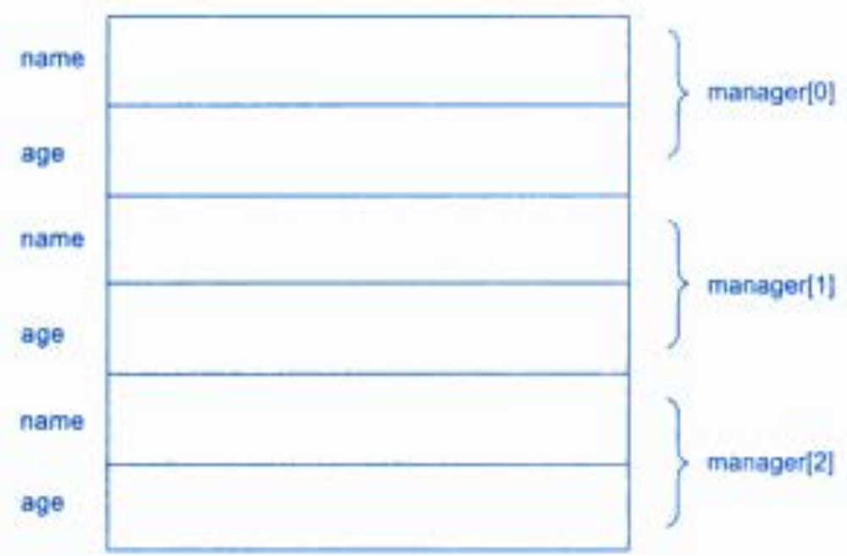
Storage of An Object Array

Slide 4
Arrays of Objects
#include <iostream>
using namespace std;
class employee
{
char name[20];
float age;
public:
void getdata();
void putdata();
};
void employee :: getdata()
{
cout<<"\nEnter name: ";
cin >>name;
cout<<"\nEnter age: ";
cin>>age;
}
void employee :: putdata()
{
cout<<"\nName: "<<name;
cout<<"\tAge: "<<age;
}
int main()
{
employee manager[3];
for(int i=0; i<3; i++)
{
cout<<"\nDetails of Manager"<<i+1;
manager[i].getdata();
}
for(int i=0; i<3; i++)
{
cout << "\nManager"<<i+1;
manager[i].putdata();
}
}

Slide 5
Objects as Function Arguments
Like other variables, an object can also be used as a function argument.
This can be done in three ways:
  Pass-by-Value: A copy of the entire object is passed to the function.
  Pass-by-Address: Only the address of the object is transferred to the function.
  Pass-by-Reference: Only the reference of the object is transferred to the function.

Slide 6
Objects as Function Arguments
Pass-by-value. - Since a copy of the entire object is passed to the function, any changes made to the object inside the function do not affect the object used to call the function.
Pass-by-Address/Pointer - When an address of the object is passed, the called function works indirectly on the actual object used in the call. This means that any changes made to the object inside the function will reflect in the actual object.
Pass-by-Reference - When a reference of the object is passed, the called function works directly on the actual object used in the call. This means that any changes made to the object inside the function will reflect in the actual object.
Pass-by Address/ Reference methods are more efficient since they require to pass only the address/ reference of the object and not the entire object.

Slide 7
Objects as Function Arguments
void time :: sum(time tl , time t2)
{
minutes = tl.minutes + t2.minutes;
hours = minutes/60;
minutes = minutes%60;
hours = hours + tl.hours + t2.hours;
}
int main()
{
time T1, T2, T3;
T1.gettime(2, 45);
T2.gettime(3, 30);
T3.sum(T1, T2); // Passing Objs as Args
cout <<"Tl = "; T1.puttime();
cout <<"T2 = "; T2.puttime();
cout <<"T3 = "; T3.puttime();
}
class time
{
int hours;
int minutes;
public:
void gettime(int h, int m)
{
hours = h;
minutes = m;
}
void puttime()
{
cout <<hours<<" hours and ";
cout <<minutes<<" minutes "<<"\n";
}
void sum(time, time);
};

Slide 8
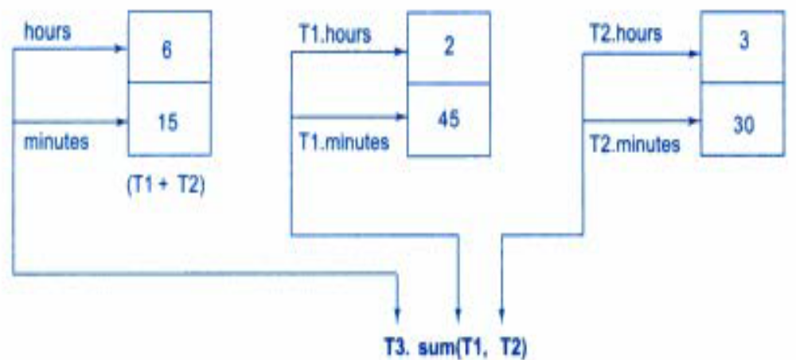
Objects as Function Arguments
Accessing members of objects within a called function

Slide 9
Returning Objects
A function cannot only receive objects as arguments, but also can return them
Program to add 2 complex numbers to produce a third complex number
class time
{
int hours;
int minutes;
public:
void gettime(int h, int m)
{
hours = h;
minutes = m;
}
void puttime()
{
cout <<hours<<" hours and ";
cout <<minutes<<" minutes "<<"\n";
}
time sum(time, time);
};
time time :: sum(time tl , time t2)
{ time t;
t.minutes = tl.minutes + t2.minutes;
t.hours = minutes/60;
t.minutes = minutes%60;
t.hours = hours + tl.hours + t2.hours;
return(t);
}
int main()
{
time T1, T2, T3;
T1.gettime(2, 45);
T2.gettime(3, 30);
T3 = T3.sum(T1, T2); // Returning Objs
cout <<"Tl = "; T1.puttime();
cout <<"T2 = "; T2.puttime();
cout <<"T3 = "; T3.puttime();
}

